Slide 1
AirBNB
Data Analysis
By : MOKH ZUHAL MUFLIH

Slide 2
01
DATA OVERVIEW
Get the big picture of what the data is about.
02
DATA INSPECTION
Inspect the properties of the data in each column (type, missing value, etc)
03
DATA STATISTIC
Show the amount of data, mean, median, and std.
How much is the min and max price?
What to Do ?
04
HANDLING MISSING VALUE
Get rid of the missing value: .
05
DATA FILTERING
Make category based on the price: Cheap, Medium, and Expensive
Filter all data which has last_review in >2019
06
DATA VISUALIZATION
Visualize the price to compare the price of available rooms

Slide 3
Data Overview

Slide 4

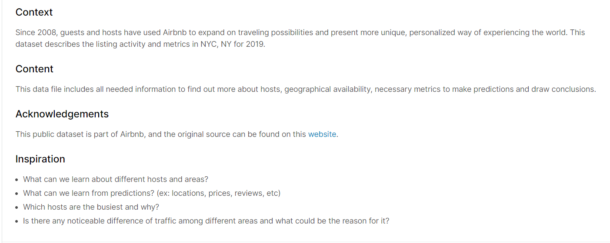
Dataset A

Slide 5
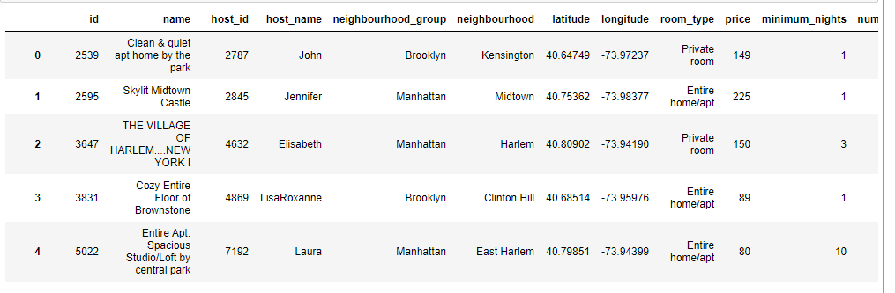
Content
bnb = pd.read_csv('Data/airbnb.csv')
bnb

Slide 6
Data Inspection

Slide 7


Shape of the Data
bnb.shape

Slide 8
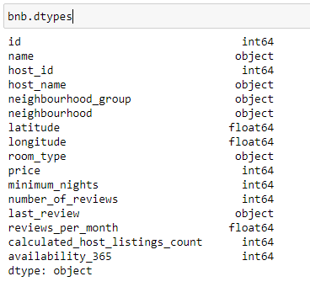
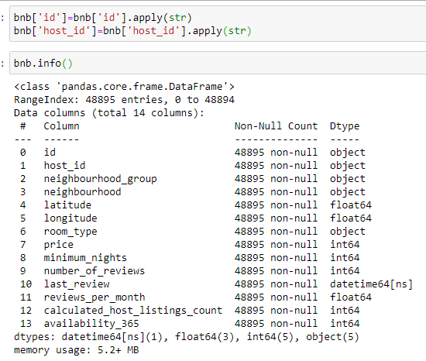
Type of the Data
bnb.dtypes

Slide 9
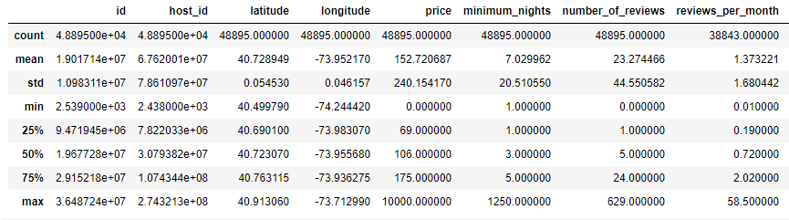
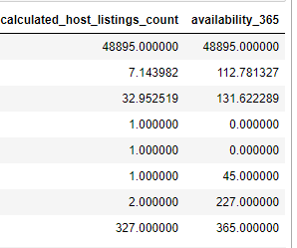
Data Properties
bnb.describe()

Slide 10
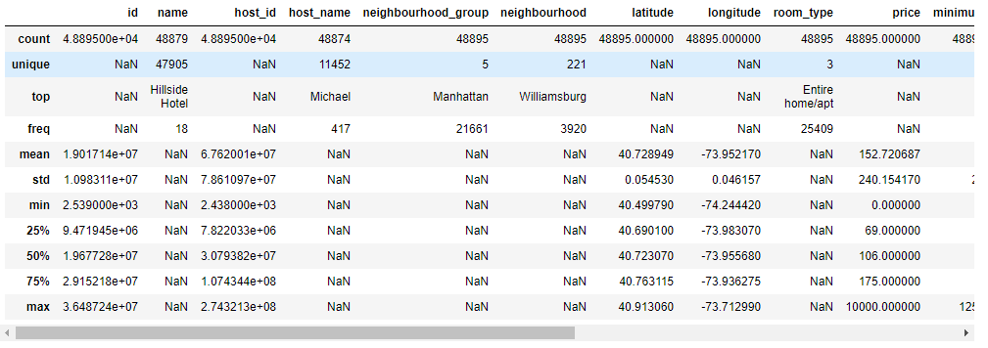
Showing Missing Values
bnb.describe()

Slide 11
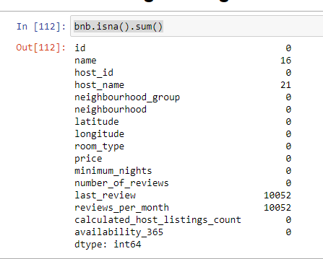
How Much the Missing
Value data?
bnb.isna().sum()

Slide 12
Data Statistic

Slide 13
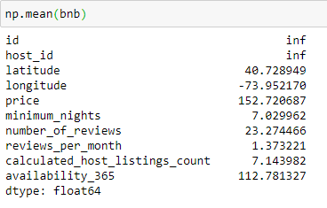
Mean
np.mean(bnb)

Slide 14
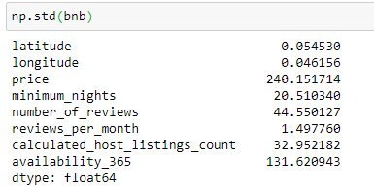
Standard Deviasion
np.std(bnb)

Slide 15
Minimum Values
np.min(bnb)

Slide 16
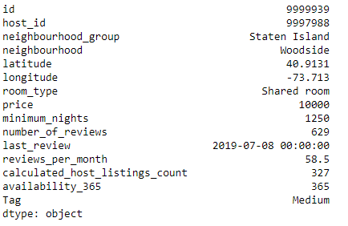
Maximum Values
np.max(bnb)

Slide 17
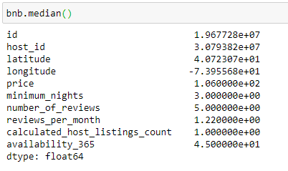
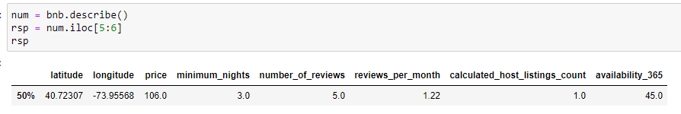
Median Values

Slide 18
Handling Missing Value

Slide 19
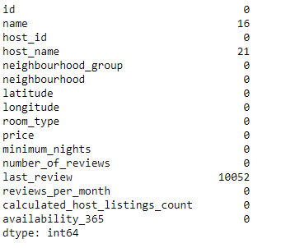
Fill the missing value in reviews_per_month with the mean
bnb['reviews_per_month'] = bnb['reviews_per_month'].fillna(bnb['reviews_per_month'].mean())
bnb.isna().sum()

Slide 20
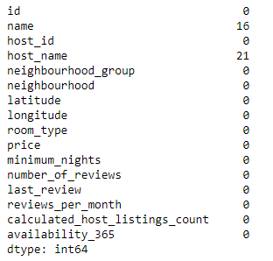
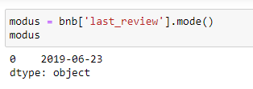

Fill the missing value in last_review with the most common date

Slide 21
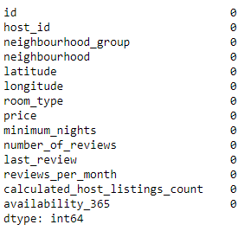

Drop columns which has missing value that cannot be filled with any logical value

Slide 22
Data Filtering

Slide 23
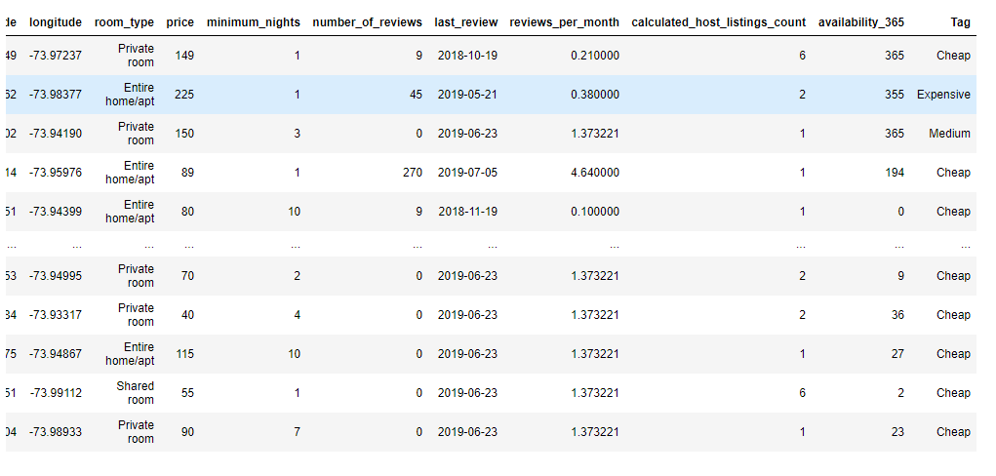
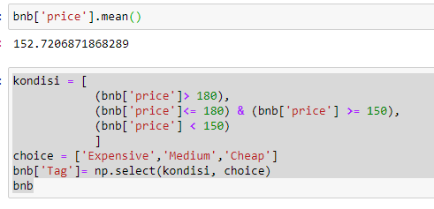
Make category based on the price: Cheap, Medium, and Expensive

Slide 24
Data Visualization

Slide 25
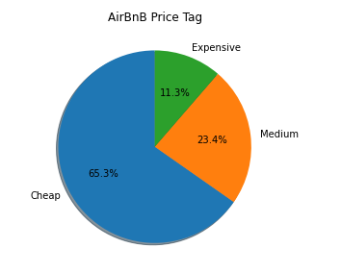
Distribution of Price Tag

Slide 26
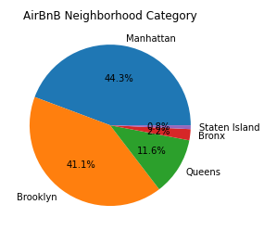
Where is the most Airbnb partner places?

Slide 27
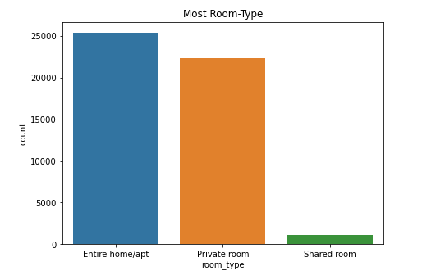
The Airbnb Most room-type?

Slide 28
THANK YOU
Insert the Subtitle of Your Presentation

